Slide 1


Pelluru Pavan Kumar Reddy
10th August 2024

Slide 2

Outline
Executive Summary
Introduction
Methodology
Results
Conclusion
Appendix

Slide 3
Executive Summary
Summary of methodologies
- Data Collection through API
Data Collection with Web Scraping
Data Wrangling
Exploratory Data Analysis with SQL
Exploratory Data Analysis with Data Visualization
Interactive Visual Analytics with Folium
Machine Learning Prediction
Summary of all results
Exploratory Data Analytics result
Interactive insights (screenshots)
Predictive Analytics result

Slide 4
Introduction
Project background and context
Space X advertises Falcon 9 rocket launches on its website with a cost of 62 million dollars, other providers cost upward of 165 million dollars each, much of the savings is because Space X can reuse the first stage. Therefore, if we can determine if the first stage will land, we can determine the cost of the launch. This info can be used if an alternative company wants to bid against space X for a project launch. This goal of the project is to create a machine learning pipeline to predict if the first stage will land successfully.
Problems you want to find answers
What factors determine if the rocket will land successfully?
The interaction amongst various features that determine the success rate of a successful landing.
What operating conditions needs to be in place to ensure a successful landing program.

Slide 5

Section 1

Slide 6
Methodology
Executive Summary
Data collection methodology:
Collected using SpaceX API and web scraping from Wikipedia
Perform data wrangling
Usage of One-hot encoding
Perform exploratory data analysis (EDA) using visualization and SQL
Perform interactive visual analytics using Folium and Plotly Dash
Perform predictive analysis using classification models
How to build, tune, evaluate classification models

Slide 7
Data Collection
Describe how data sets were collected.
Data collection process involved a combination of API requests from SpaceX REST API and Web Scraping data from a table in SpaceX’s Wikipedia entry. Both these methods were utilized in order to get complete info about the launches.
Data columns like the FlightNumber, Date, BoosterVersion, PayloadMass, Orbit, LaunchSite, Outcome, Flights, GridFins, Reused, Legs, LandingPad, Block etc were obtained using SpaceX REST API.
Data columns like the Flight No., Launch Site, Payload, Payload Mass, Orbit, Customer, launch outcome were obtained by using Wikipedia Web Scraping.

Slide 8
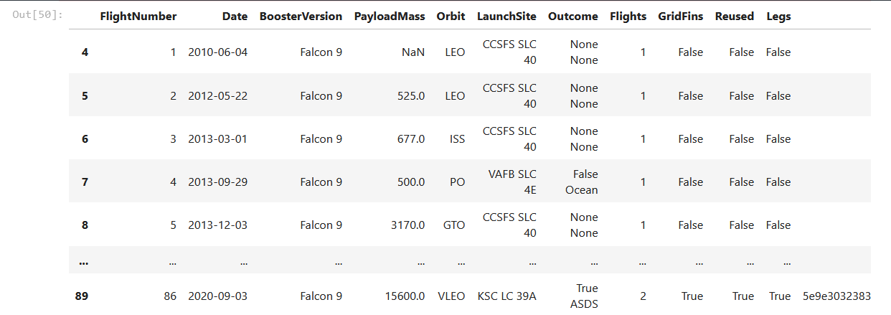
Data Collection – SpaceX API
The API used is https://api.spacexdata.com/v4/rockets/.
The API provides data about many types of rocket launches done by SpaceX, the data is therefore filtered to include only Falcon 9 launches.
Every missing value in the data is replaced the mean the column that the missing value belongs to.
Notebook Link: https://github.com/Pavanreddy-2003/IBM-Data-Science-Capstone/blob/main/%5B1%5D%20Data%20Collection%20API.ipynb

Slide 9
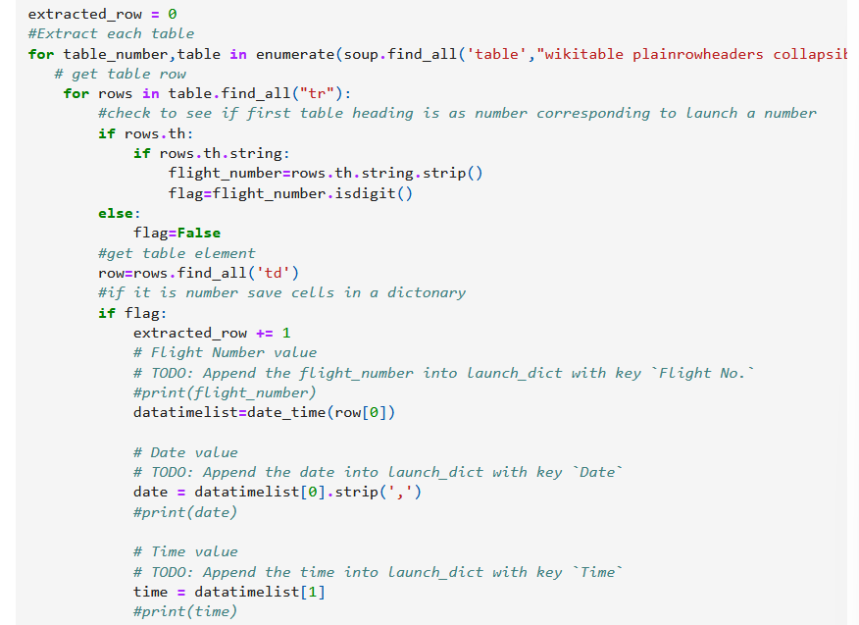
Data Collection - Scraping
Applied Web Scraping to webscrap Falcon 9 launch records with BeautifulSoup.
Parsed the table and converted it into a pandas dataframe.
Notebook Link: https://github.com/Pavanreddy-2003/IBM-Data-Science-Capstone/blob/main/%5B2%5D%20Data%20Collection%20with%20Web%20Scraping%20.ipynb

Slide 10
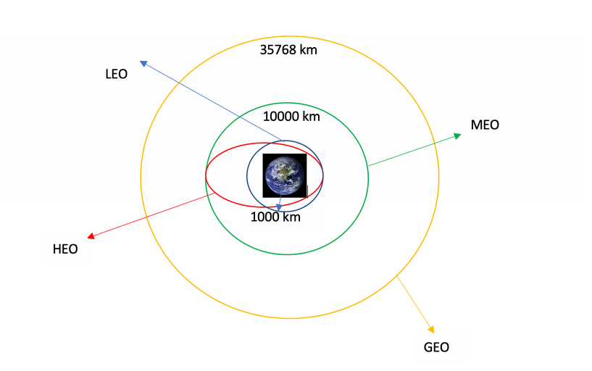
Data Wrangling
Calculated number of launches at each site, and the number and occurrence of each orbits and exported the results into csv file.
Notebook link: https://github.com/Pavanreddy-2003/IBM-Data-Science-Capstone/blob/main/%5B3%5D%20Data%20Wrangling.ipynb

Slide 11
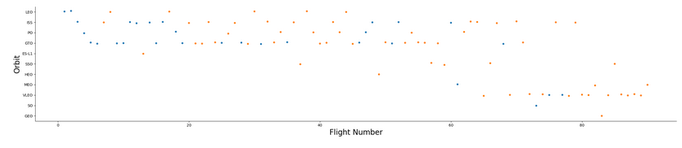
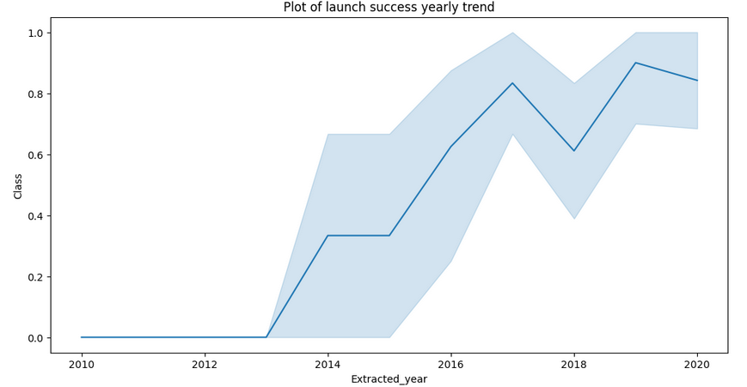
EDA with Data Visualization
Explored data by visualizing relationship between columns like flight number and launch site, payload and launch site, success rate of each orbit type, flight number and orbit type, the launch success yearly trend.
Notebook link: https://github.com/Pavanreddy-2003/IBM-Data-Science-Capstone/blob/main/%5B5%5D%20EDA%20Visualization.ipynb

Slide 12
EDA with SQL
Loaded the SpaceX dataset into PostgreSQL database without leaving the jupyter notebook.
Then applied EDA with SQL to get insight from the data. Wrote queries to find out for instance:
The names of unique launch sites
Total payload mass carried by boosters launched by NASA(CRS)
Average payload mass carried by booster version F9 v 1.1
Notebook Link: https://github.com/Pavanreddy-2003/IBM-Data-Science-Capstone/blob/main/%5B4%5D%20EDA%20With%20SQL.ipynb

Slide 13
Build an Interactive Map with Folium
We marked all launch sites, and added map objects such as markers, circles, lines to mark the success or failure of launches for each site on the folium map.
We assigned the feature launch outcomes (failure or success) to class O and 1.i.e., O for failure, and 1 for success.
Using the color-labeled marker clusters, we identified which launch sites have relatively high success rate.
We calculated the distances between a launch site to its proximities. We answered some question for instance:
Are launch sites near railways, highways and coastlines.
Do launch sites keep certain distance away from cities.

Slide 14
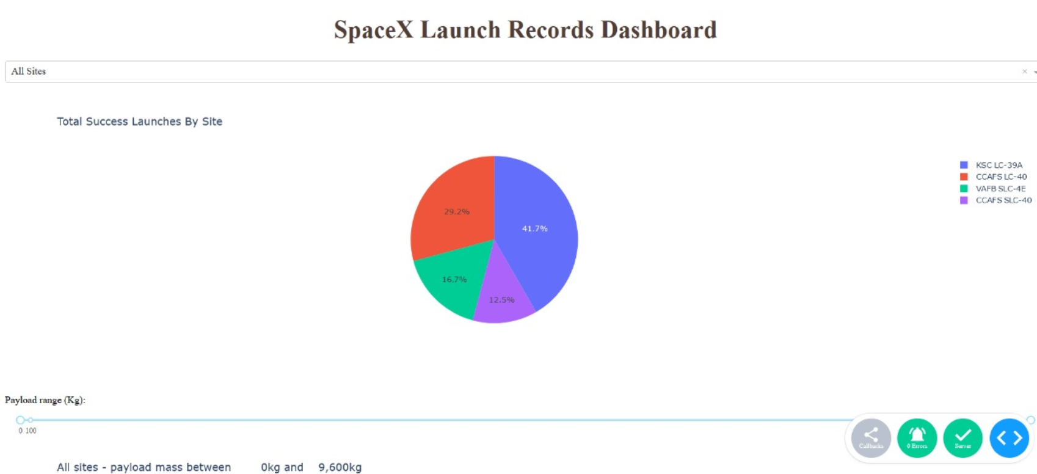
Build a Dashboard with Plotly Dash
Built an interactive dashboard with Plotty dash
Plotted pie charts showing total launches by a certain sites
Plotted scatter graph showing relationship with outcome and payload mass(Kg) for different booster version
Notebook link: https://github.com/Pavanreddy-2003/IBM-Data-Science-Capstone/blob/main/%5B7%5D%20spacex_dash_app.py

Slide 15
Predictive Analysis (Classification)
Loaded the data using numpy and pandas, transformed the data, split out data into training and testing
Created a GridSearch CV object with cv = 10 to find the best parameters
Applying GridSearchCV on LogReg, SVM, Decision Tree and KNN models
Calculating the accuracy on the test data using the method.score() method
Examining the confusion matrix for all models
Finding the method that performs the best by examining the Jaccard_score and F1_score metrics
Notebook Link: https://github.com/Pavanreddy-2003/IBM-Data-Science-Capstone/blob/main/%5B8%5D%20Machine%20Learning%20Pediction.ipynb

Slide 16
Results
Exploratory data analysis results
Interactive analytics demo in screenshots
Predictive analysis results

Slide 17

Section 2

Slide 18
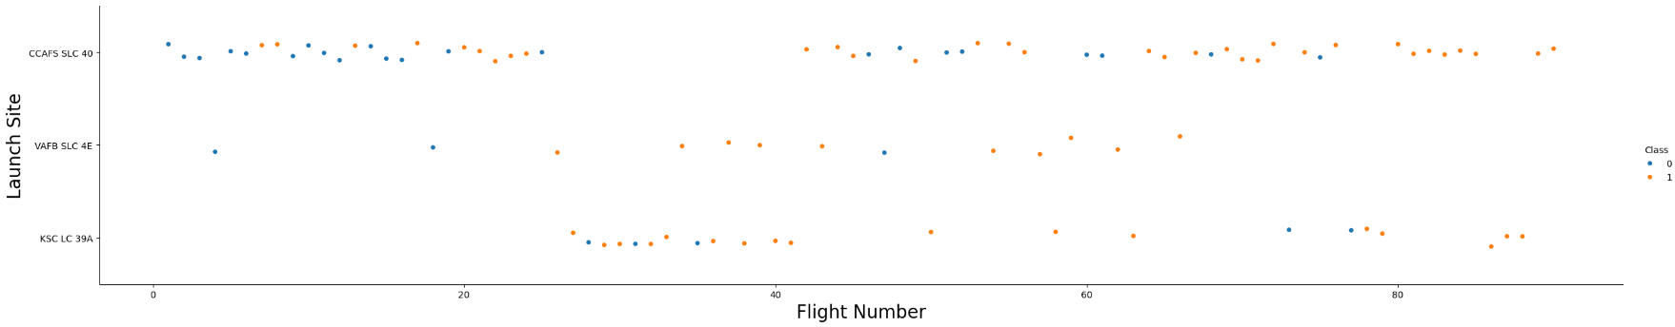
Flight Number vs. Launch Site
We can infer from the plot that larger the flight amount at a launch site, greater the success rate at a launch site.

Slide 19
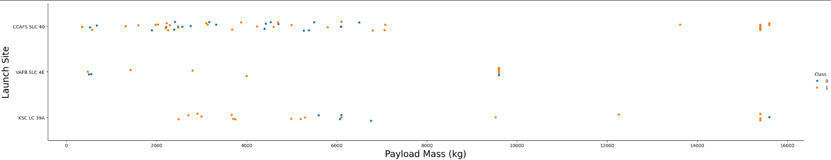
Payload vs. Launch Site
Greater the payload mass for launch site CCAFS SLC 40, higher the success rate.

Slide 20
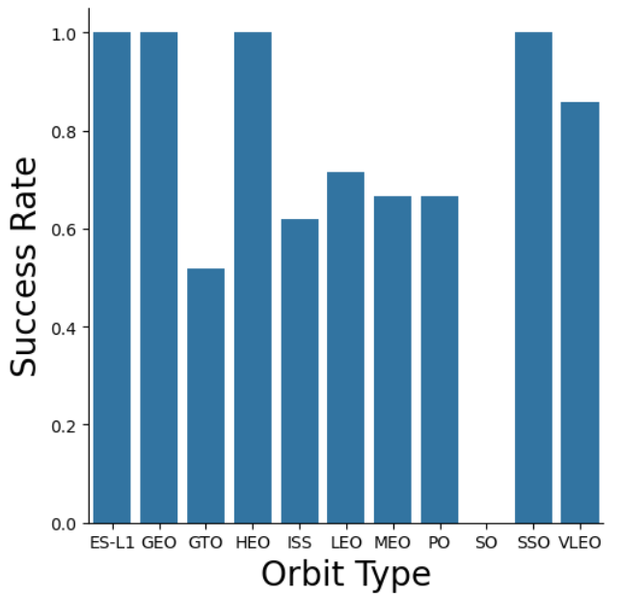
Success Rate vs. Orbit Type
ES-L1, GEO, HEO, SSO, VLEO have the most success rate.

Slide 21
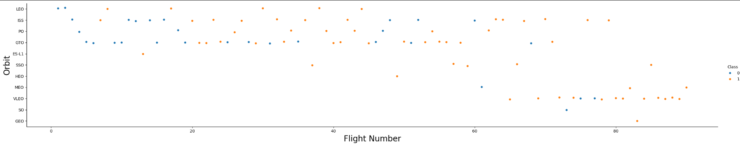
Flight Number vs. Orbit Type
In LEO orbit, success is related to number of flights whereas in the GTO orbit, there is no relationship between flight number and orbit

Slide 22
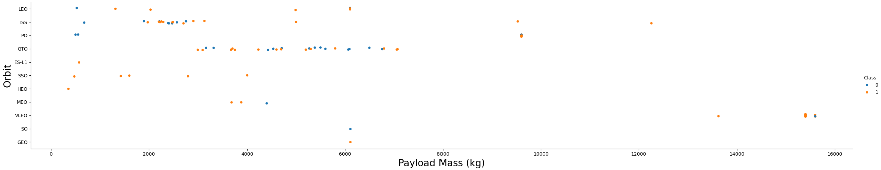
Payload vs. Orbit Type
Successful landing is more for PO, LEO and ISS orbits

Slide 23
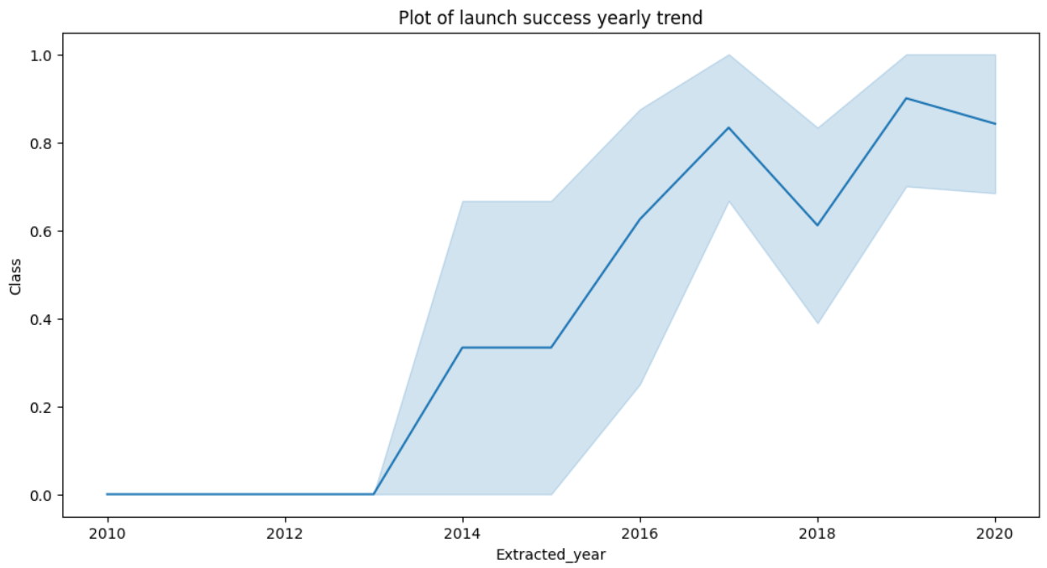
Launch Success Yearly Trend
Success rate has been increasing from 2013 to 2020

Slide 24
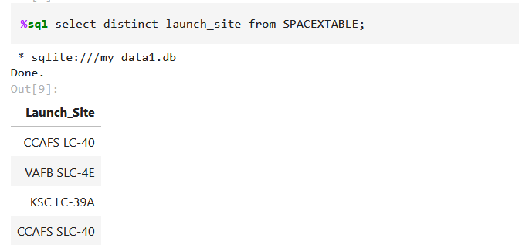
All Launch Site Names
Keyword DISTINCT is used to show only unique launch sites form the SpaceX data.

Slide 25
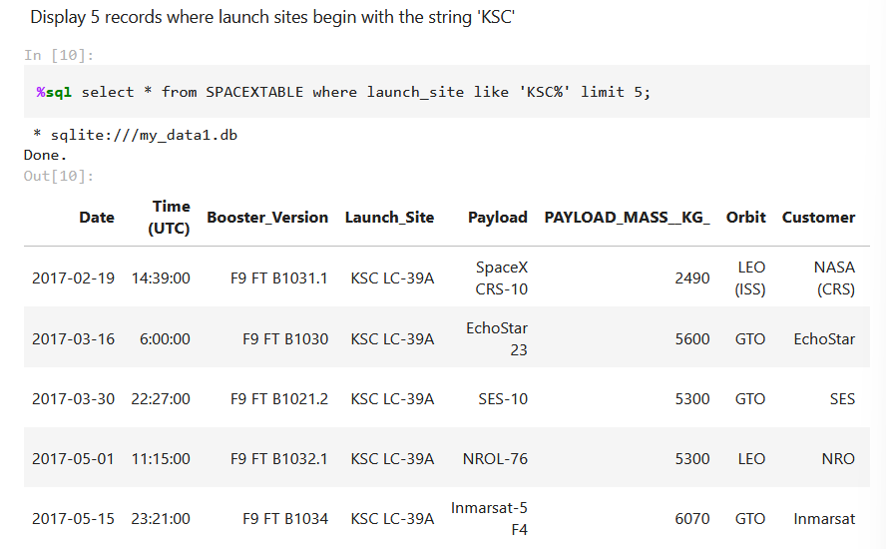
Launch Site Names Begin with 'KSC'

Slide 26
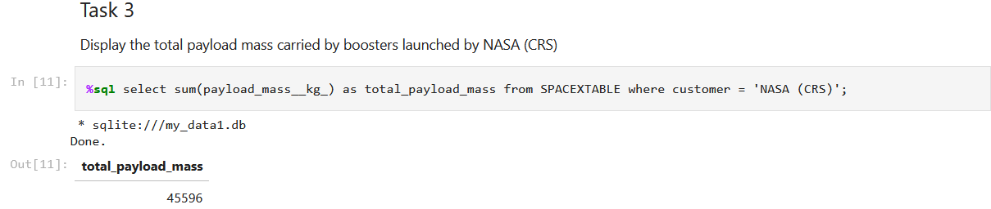
Total Payload Mass

Slide 27
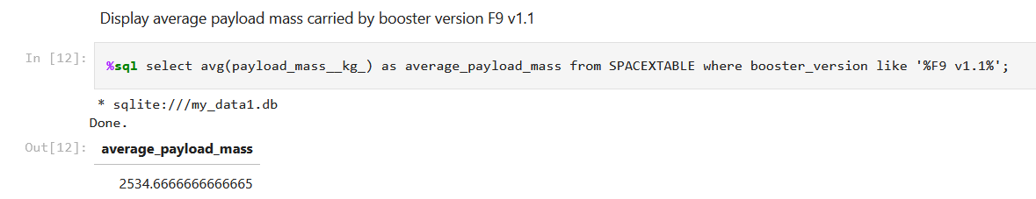
Average Payload Mass by F9 v1.1

Slide 28
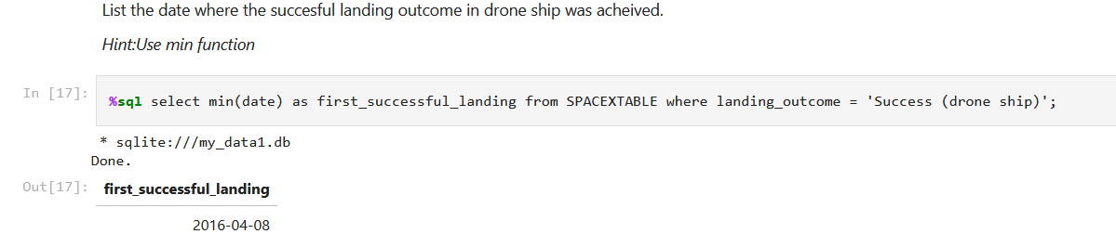
First Successful Ground Landing Date
As we can see, the first successful landing outcome on drone ship was 8th April 2016.

Slide 29
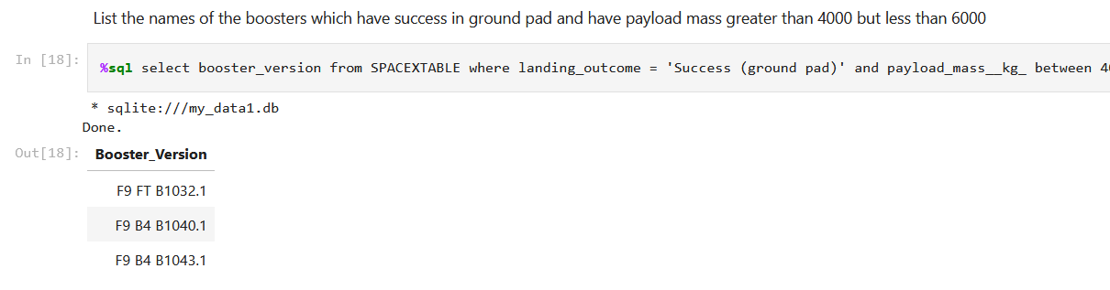
Successful Drone Ship Landing with Payload between 4000 and 6000
We used the WHERE clause to filter for boosters which have successfully landed on drone ship and applied the AND condition to determine successful landing with payload mass greater than 4000 but less than 6000

Slide 30
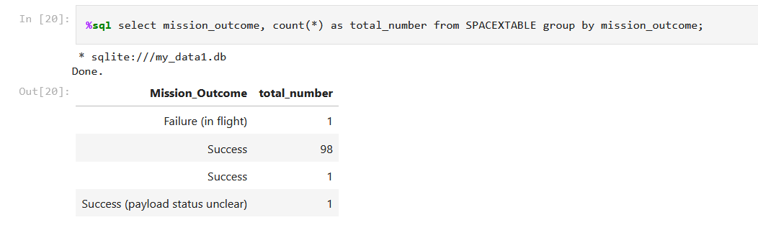
Total Number of Successful and Failure Mission Outcomes

Slide 31
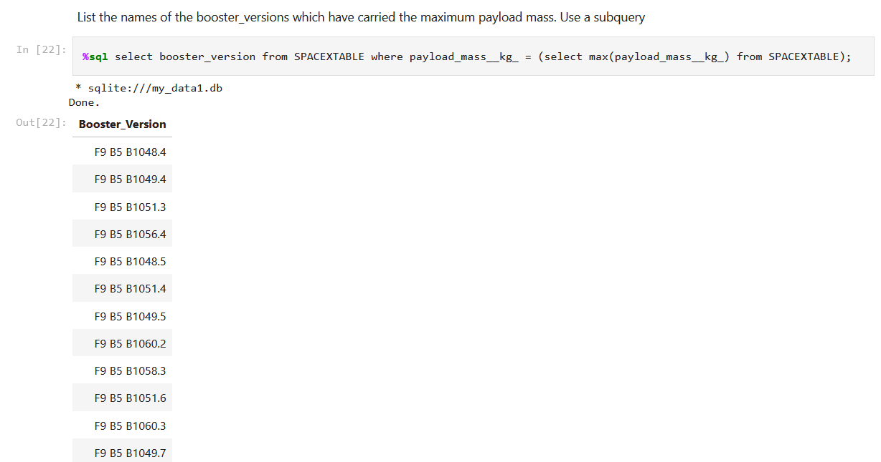
Boosters Carried Maximum Payload

Slide 32
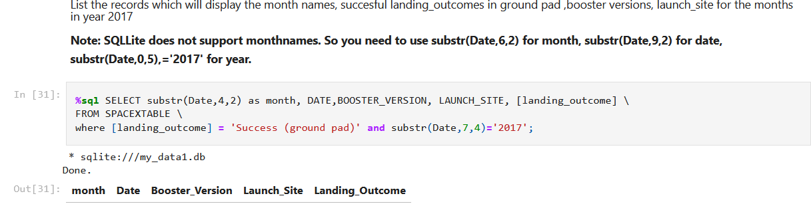
2015 Launch Records
List the records which will display the month names, succesful landing_outcomes in ground pad ,booster versions, launch_site for the months in year 2017

Slide 33
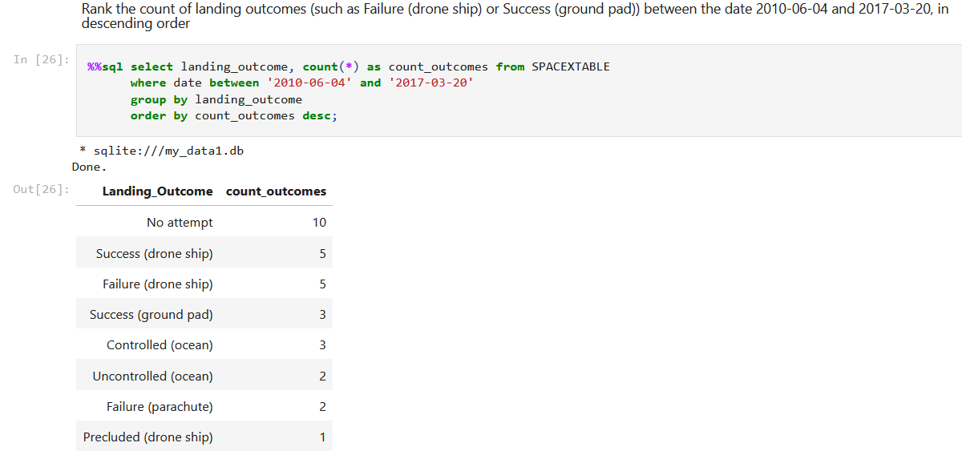
Rank Landing Outcomes Between 2010-06-04 and 2017-03-20
Selected landing outcomes and the COUNT of landing outcomes form the data and used the WHERE clause to filter for landing outcomes BTEWEEN the dates
Then applied GROUP BY clause to group the landing outcomes and the ORDER BY clause to order the grouped landing outcome in descending order.

Slide 34

Section 3

Slide 35

Launch sites Global Map Markers

Slide 36
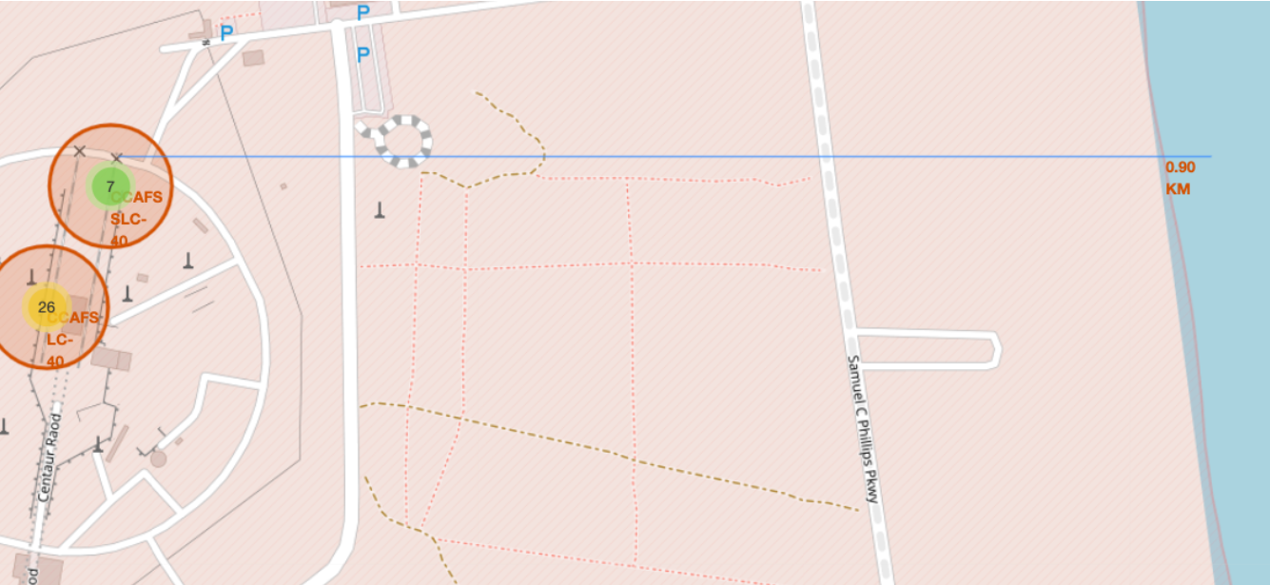
Launch Site distance to landmarks

Slide 37

Section 4

Slide 38
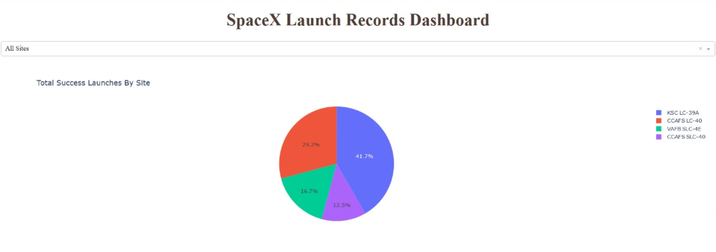
Pie chart showing success % achieved by each launch site

Slide 39
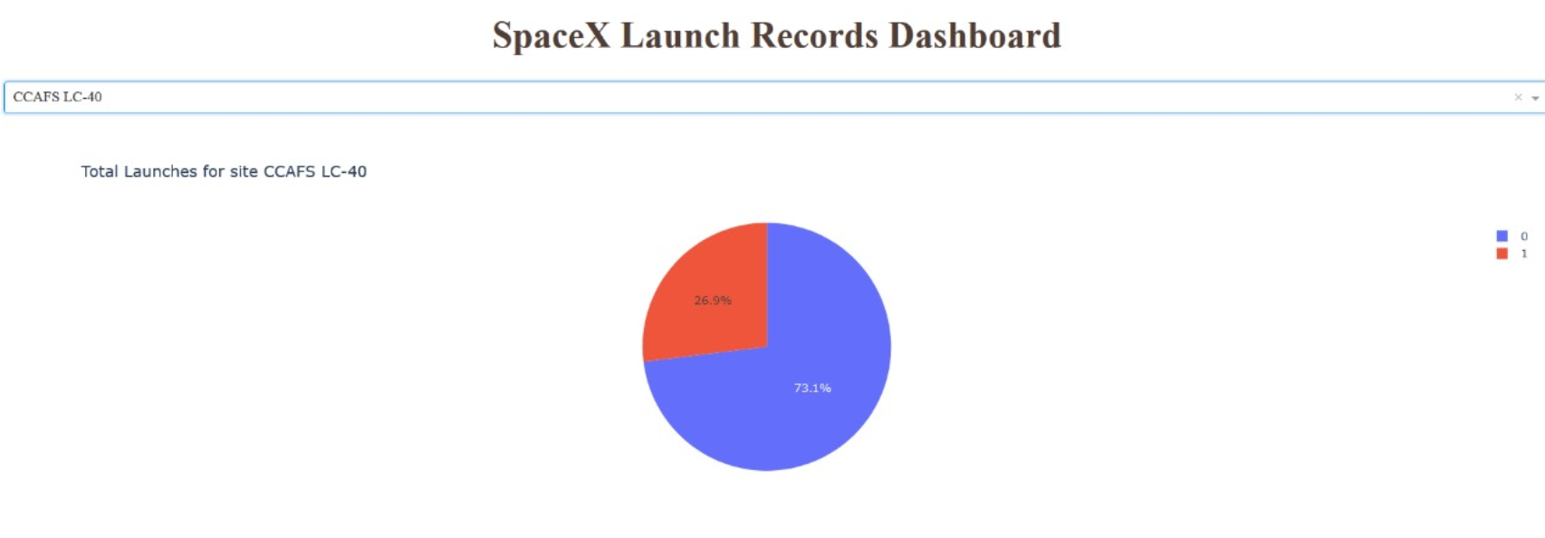
Pie chart showing launch site (CCAFS LC-40) success ratio

Slide 40
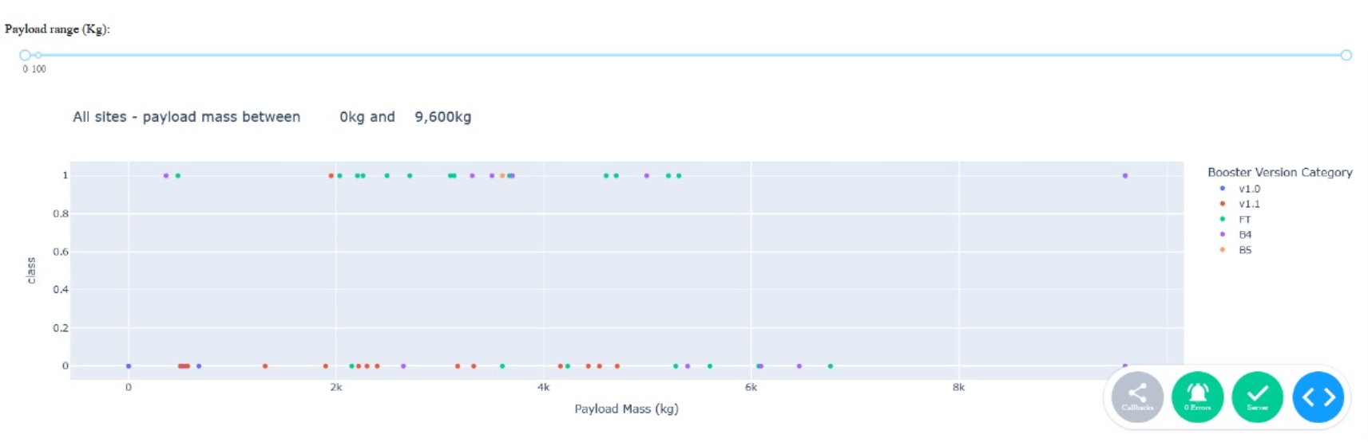
Scatter plot of Payload vs Launch Outcome for all sites, with different payload selected in the range slider

Slide 41

Section 5

Slide 42
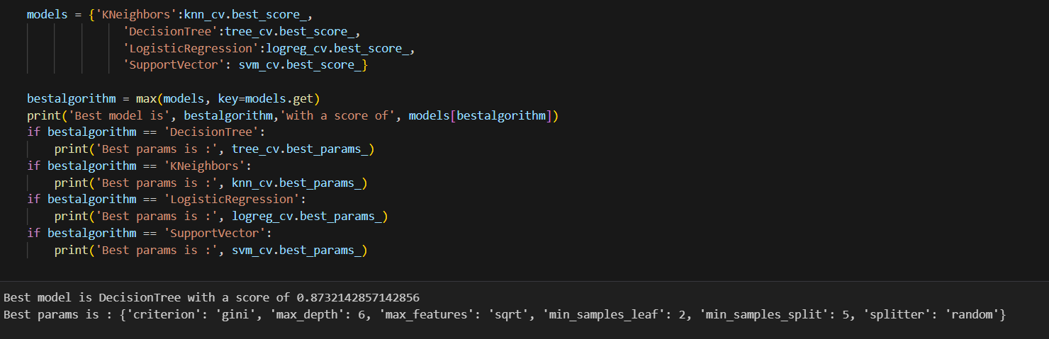
Classification Accuracy
We could infer that the decision tree classifier is the model with the highest classification accuracy.

Slide 43
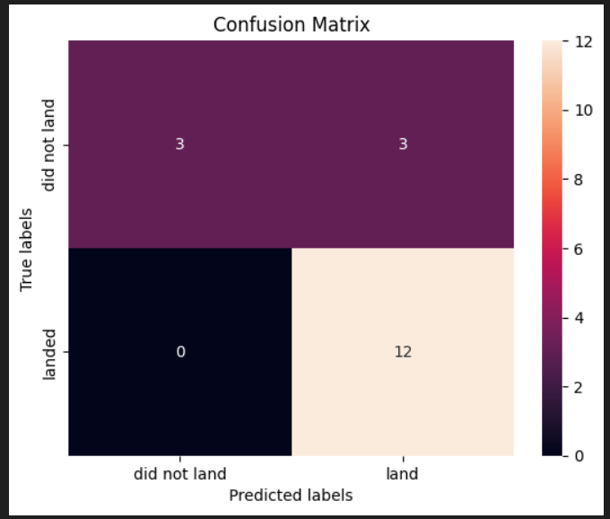
Confusion Matrix
The confusion matrix for the decision tree classifier shows that the classifier can distinguish between the different classes. The major problem is the false positives i.e., unsuccessful landing marked as successful landing by the classifier.

Slide 44
Conclusions
The larger the flight amount at a launch site, greater the success rate at a launch site.
Launch success rate started to increase from 2013 to 2020.
Orbits ES-L1, GEO, HEO, SSO, VLEO had the most success rate.
KSC LC-39A had the most successful launches of any sites.
The Decision tree classifier is the best machine learning algorithm for this task.

Slide 45
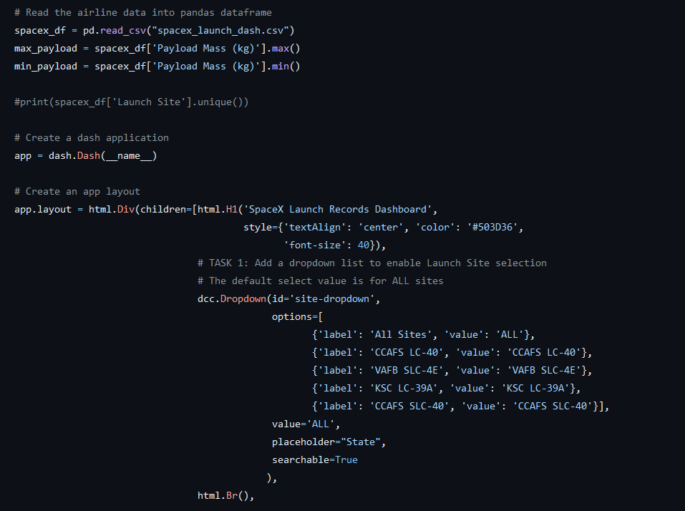
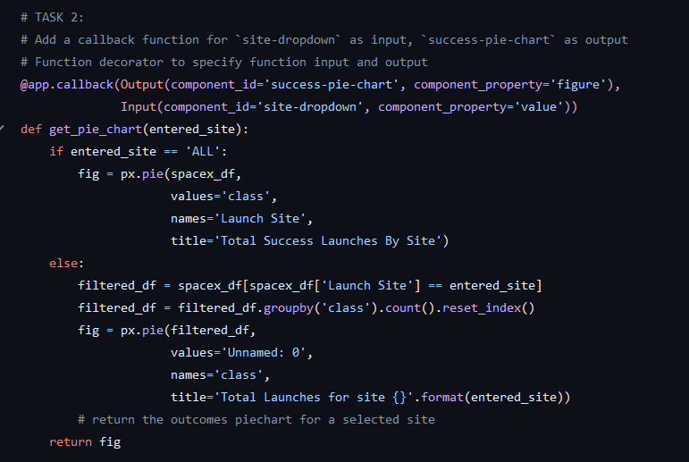
Appendix

Slide 46


